Slide 1

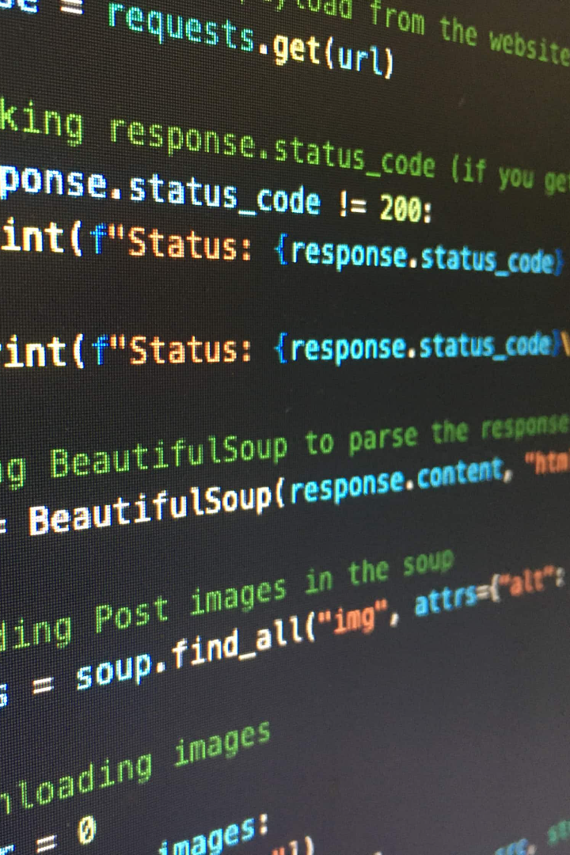

Fetch your Gmail Emails from a Particular User using Python
This presentation will guide you through the process of using Python to fetch emails from a specific Gmail user, including authentication, filtering, fetching, error handling, and additional functionality.

Slide 2

Why Fetching Gmail Emails from a Particular User is Important
Organization
Categorization
Filtering emails by a particular user can help you keep track of important conversations and reduce clutter in your inbox.
You can use this functionality to categorize and analyze emails based on their sender, for instance to monitor a specific project or client.
Automation
Fetching emails programmatically can be the first step to automating email-related tasks such as notifications, responses, or data extraction.

Slide 3
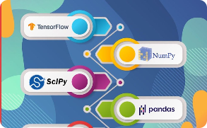
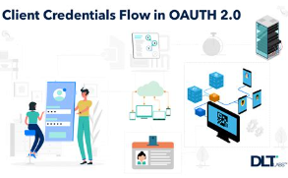
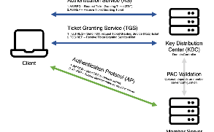
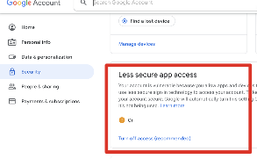
Setup and Authentication
Installation of Required Libraries
Creating OAuth Credentials
Authenticating the Application with Gmail API
Unlocking CAPTCHA Challenges
To use the Gmail API in Python, you need to install some libraries such as google-auth and google-api-python-client.
To authorize your application to access your Gmail account, you need to create a project in the Google Cloud Console and generate OAuth 2.0 credentials.
You can then use these credentials to obtain a token that allows your application to interact with the Gmail API and access the user's email data.
If there are any challenges to user authorization, such as CAPTCHAs, they must be manually unlocked before the API can be accessed.

Slide 4

Fetching Emails
1
Accessing the User's Gmail Inbox
Once authenticated, you can use the Gmail API client to get access to the user's Gmail inbox, which provides methods for retrieving emails and other messages.
2
Setting Search Parameters to Filter Emails from a Particular User
You can use the search() method to filter emails based on criteria such as sender, subject, date, label, attachment, or content.
3
Retrieving and Displaying the Fetched Emails
Once you've selected the emails you want to process, you can extract information from them, such as the sender, subject, body, attachments, or labels, and display it in a convenient format.

Slide 5
Handling Exceptions and Errors
1
Handling Invalid Credentials
2
Dealing with API Rate Limits
3
Addressing Potential Errors During the Fetching Process
If the OAuth token expires or becomes invalid, you need to refresh it to continue accessing the Gmail API.
The Gmail API imposes rate limits on the number of requests you can make in a given timeframe, so you need to implement appropriate measures to avoid being throttled.
Many things can go wrong when fetching emails programmatically, such as network errors, malformed data, or unexpected responses. You need to be prepared to handle them gracefully.

Slide 6
Additional Functionality
Parsing Email Content and Extracting Relevant Information
Saving Email Attachments
Implementing Email Notifications or Automated Actions
You can use the Gmail API to download and save the attachments of the fetched emails, for instance to archive them or process them further.
Once you have fetched emails programmatically, you can use that data to trigger other actions, such as sending notifications, updating databases, or running scripts.
You can use various Python libraries such as email, BeautifulSoup, or regex to parse the content of the fetched emails and extract specific data, such as URLs, phone numbers, addresses, or keywords.

Slide 7
Code:
import base64 import os.path from google.auth.transport.requests import Request from google.oauth2.credentials import Credentials from google_auth_oauthlib.flow import InstalledAppFlow from googleapiclient.discovery import build
If modifying these SCOPES, delete the file token.json.
SCOPES = ['https://www.googleapis.com/auth/gmail.readonly']
def authenticate_gmail(): """Shows basic usage of the Gmail API. Lists the user's Gmail labels. """ creds = None # The file token.json stores the user's access and refresh tokens, and is # created automatically when the authorization flow completes for the first # time. if os.path.exists('token.json'): creds = Credentials.from_authorized_user_file('token.json') if not creds or not creds.valid: if creds and creds.expired and creds.refresh_token: creds.refresh(Request()) else: flow = InstalledAppFlow.from_client_secrets_file( 'credentials.json', SCOPES) creds = flow.run_local_server(port=0) # Save the credentials for the next run with open('token.json', 'w') as token: token.write(creds.to_json()) return creds
def fetch_emails(user_id='me', label_id='INBOX', max_results=5): creds = authenticate_gmail() service = build('gmail', 'v1', credentials=creds)
try: response = service.users().messages().list(userId=user_id, labelIds=[label_id], maxResults=max_results).execute() messages = response.get('messages', []) for message in messages: msg = service.users().messages().get(userId=user_id, id=message['id']).execute() subject = '' for header in msg['payload']['headers']: if header['name'] == 'Subject': subject = header['value'] body = base64.urlsafe_b64decode(msg['payload']['body']['data']).decode('utf-8') # Process the email subject and body as needed print(f"Subject: {subject}\nBody: {body}\n{'-'*30}") except Exception as e: print(f"An error occurred: {e}")
if name == 'main': fetch_emails()

Slide 8
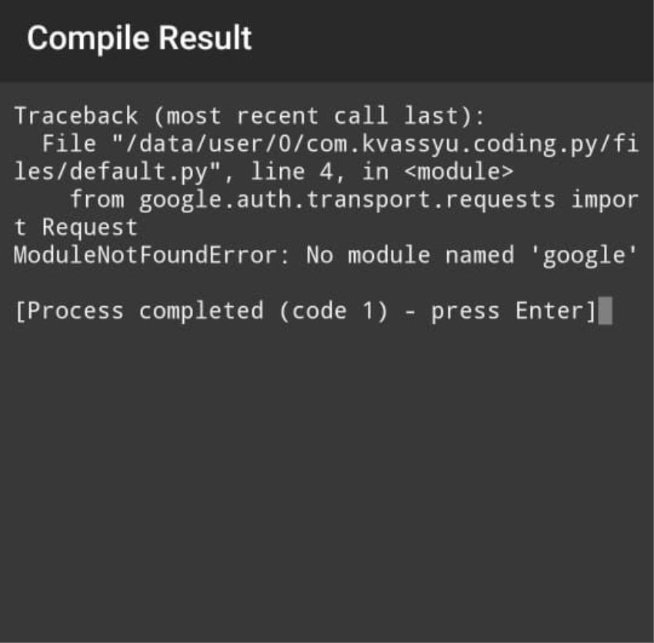
Output:

Slide 9
Conclusion
Summary of How to Fetch Gmail Emails from a Particular User using Python
Encouragement to Explore and Expand upon the Functionality
This is just the beginning of what you can achieve with the Gmail API and Python. We encourage you to explore the possibilities and find new ways to automate your email-related tasks.
We've covered the essential steps and techniques involved in fetching Gmail emails from a specific user using Python, including authentication, filtering, fetching, error handling, and additional functionality.

